Slide 1
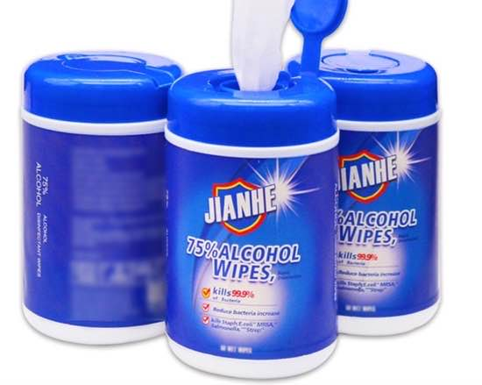
Jianhe Alcohol Wipes
Key Product Specs:
FDA Registered
75% Alcohol

Slide 2
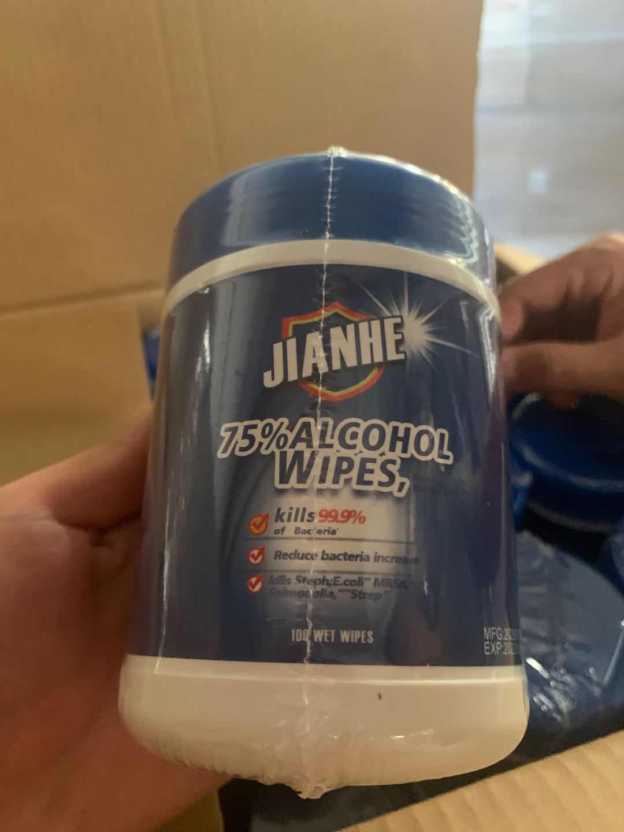
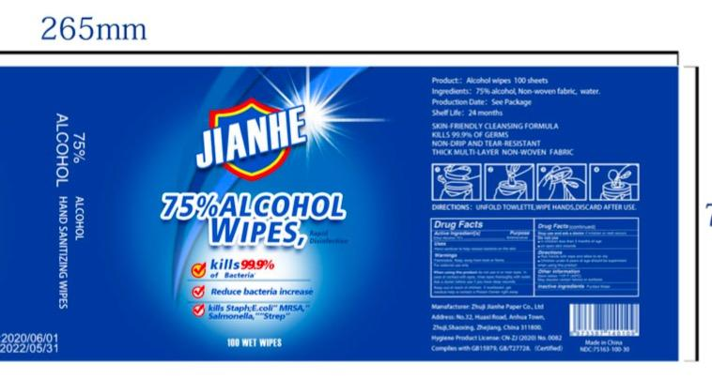
Product Display
Photo
Detail
Packing

Slide 3
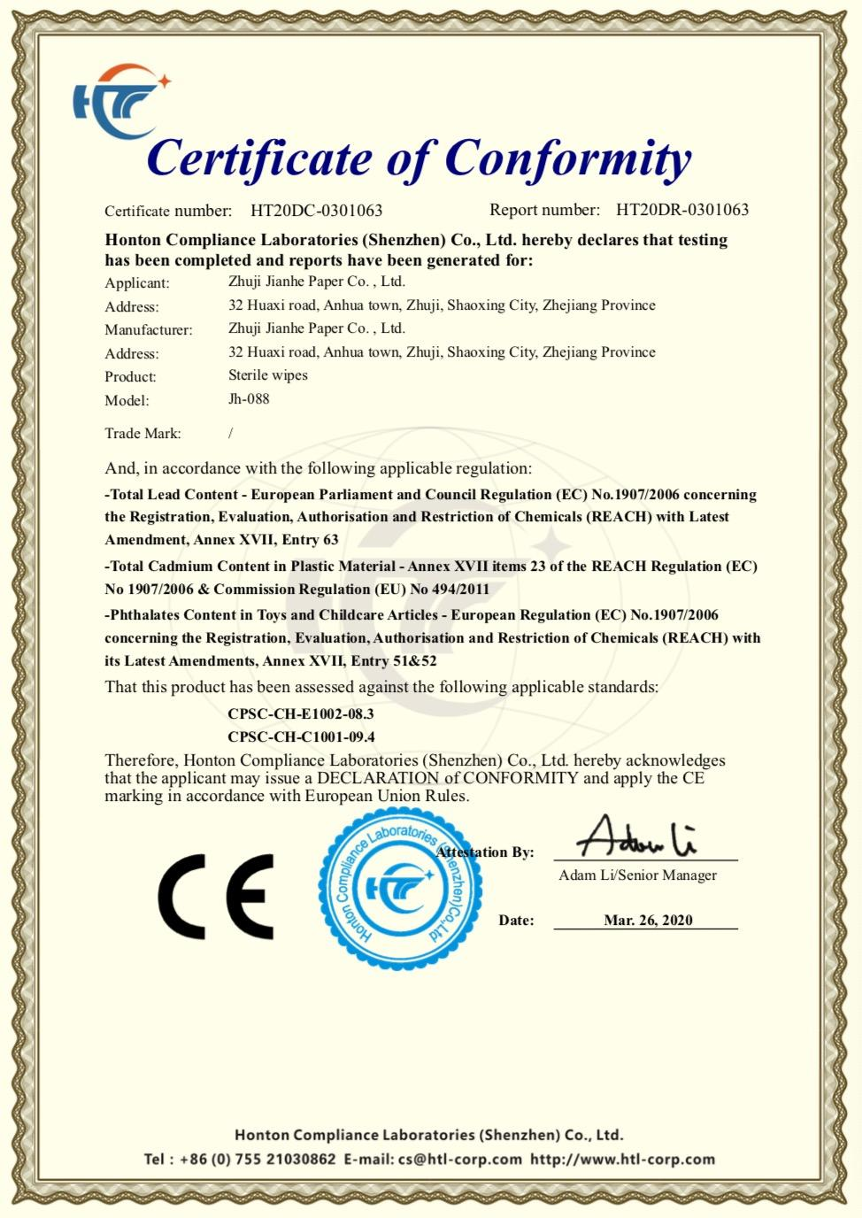
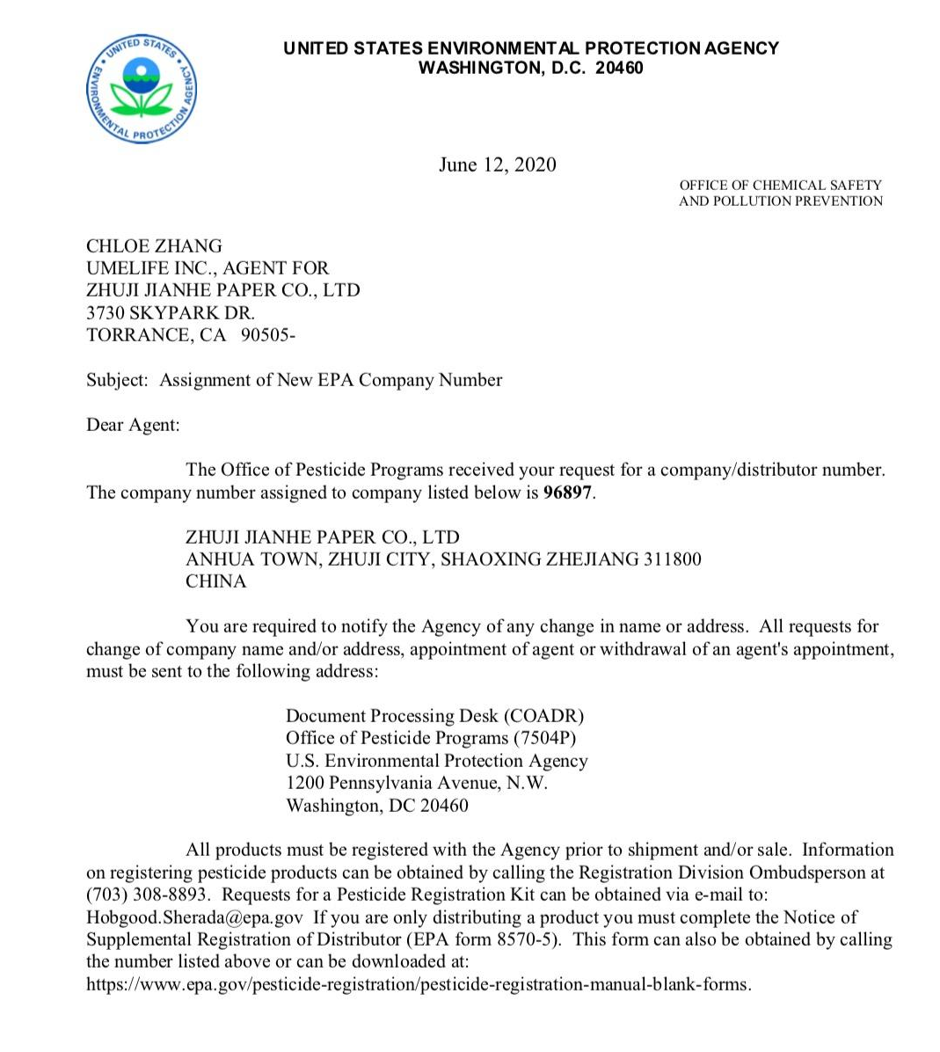
Business & Medical Licenses

Slide 4
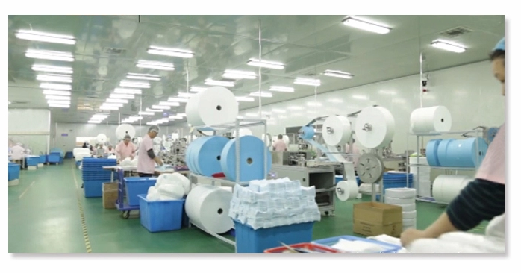
Company Info
ZHUJI Jianhe paper CO,LTD is a professional alcohol wipes manufacturer producing a wide range of alcohol products that exported across the world. Specialization and the consistent pursuit of quality along with competitive price make them stand out in the market. All the products are FDA/CE certified and registered with NDC. For EU clients, their products meet the criteria of EN 14476.

Slide 5
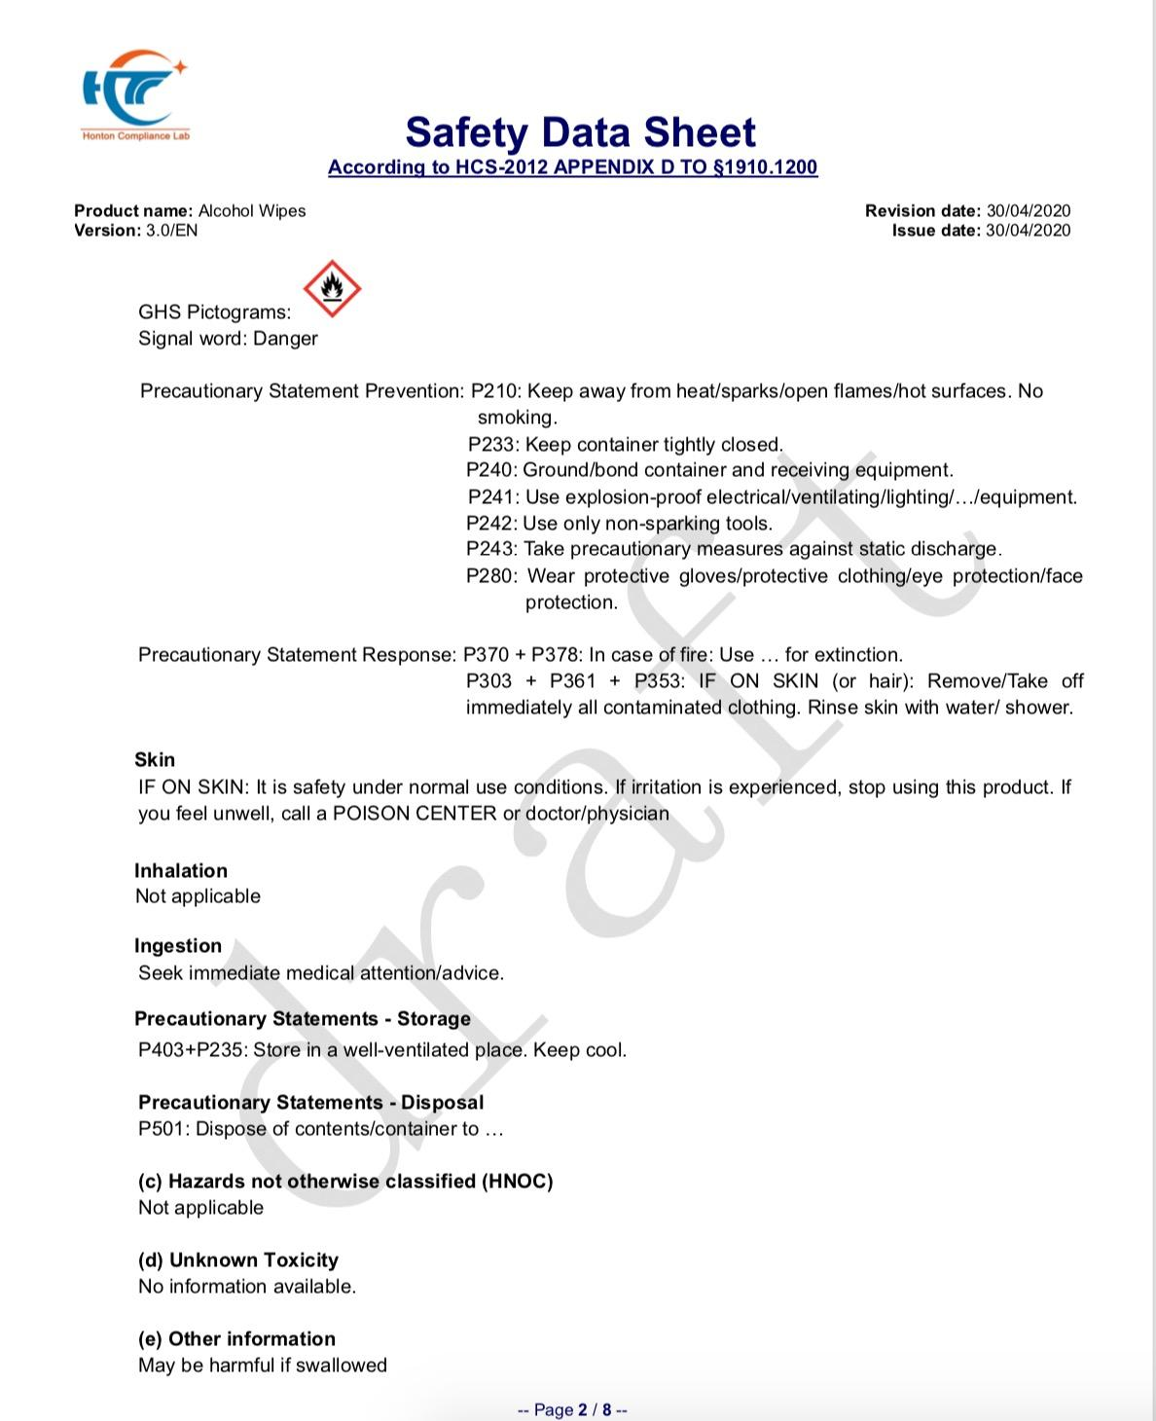
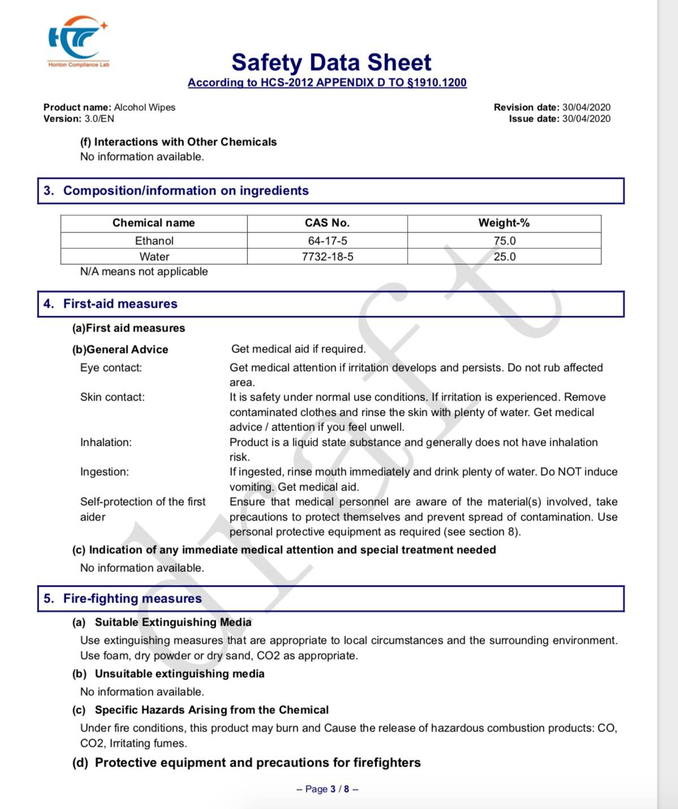
Test Report - Safety Data Sheet

Slide 6
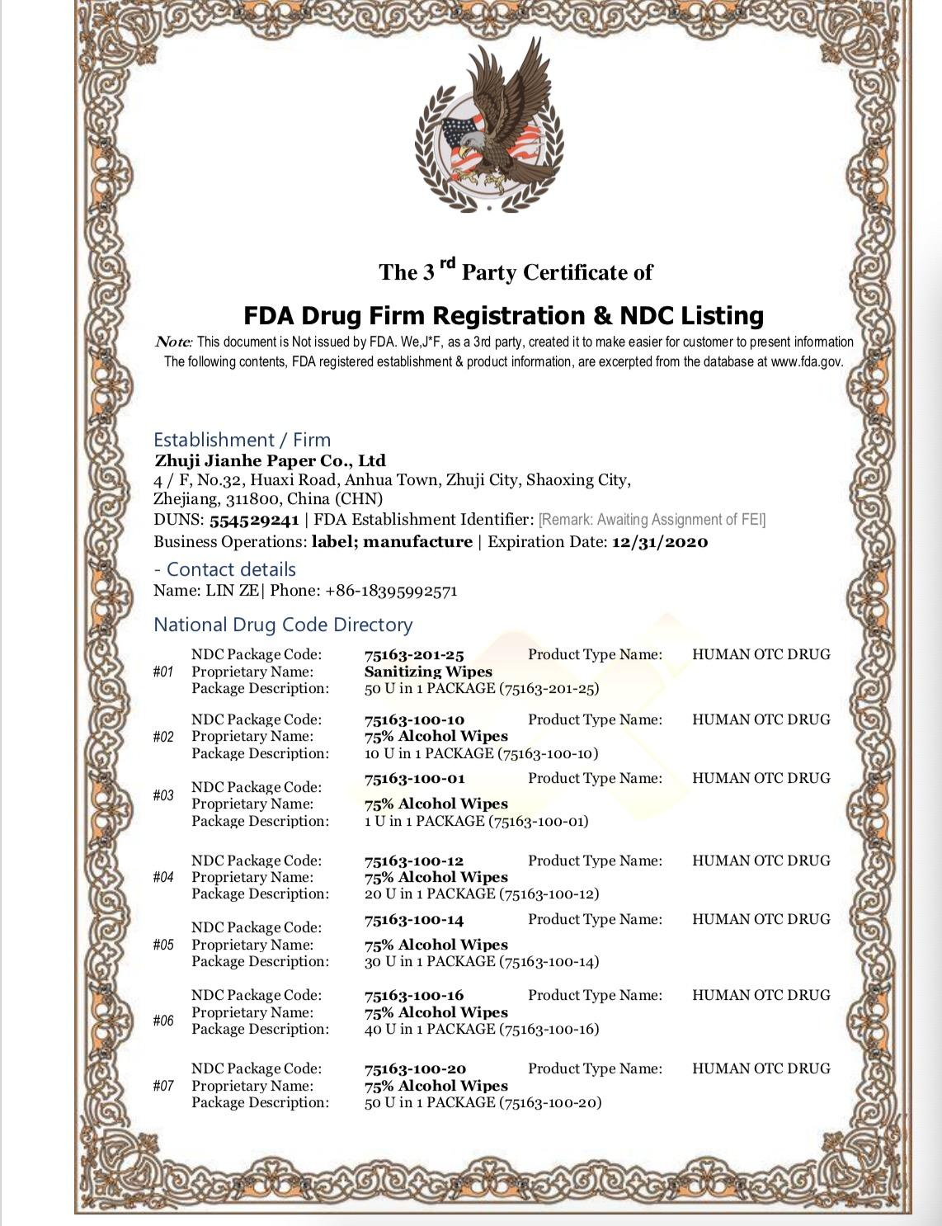
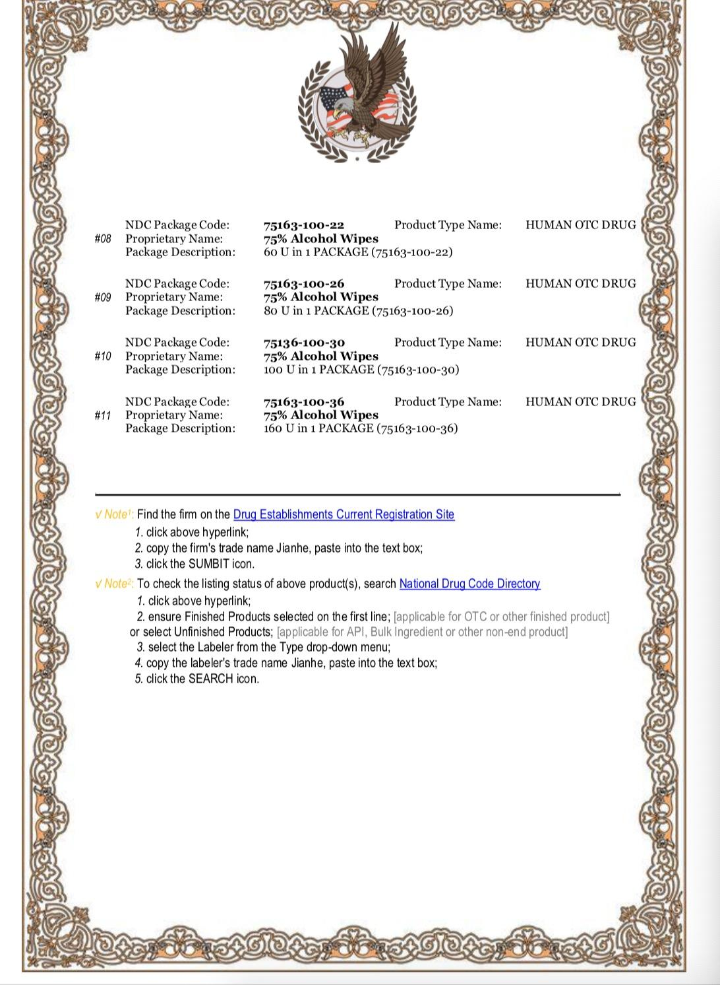
FDA Registration

Slide 7
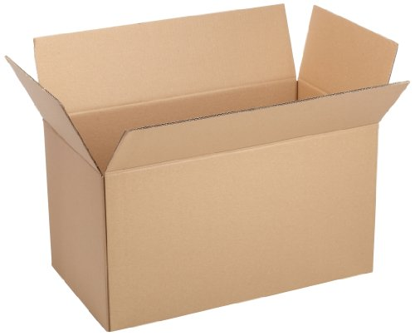
Product Package Info
100 Pcs / Container
60 Containers/ Carton (6000 Pcs)
Size: 265mm*72mm( 10.4inch*2.8inch)
Material: water, 75%Alcohol, non woven fabric
Color: White
Weight: 275g
100 Pcs per Container, 60 containers per Carton
6000 Pcs per Carton
Carton Dimension:17*14*15.15 inches
G. W.:16.5kg

