Slide 1
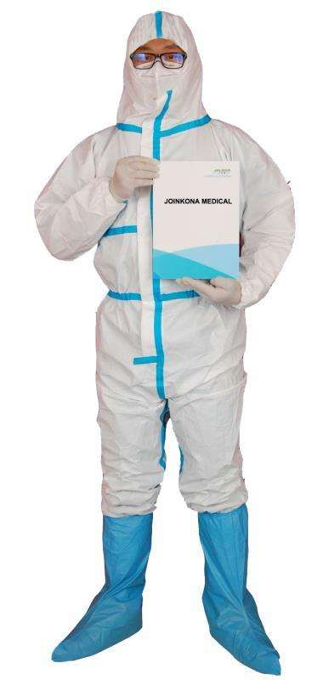
Aruikon Disposable Medical Protective Coveralls
Key Product Specs:
FDA Approved
Non sterile PP+PE
Full coverage, elastic wrist and cuffs
Zip for easy access
Taped seams to offer max protection
Size: XXL 185cm

Slide 2
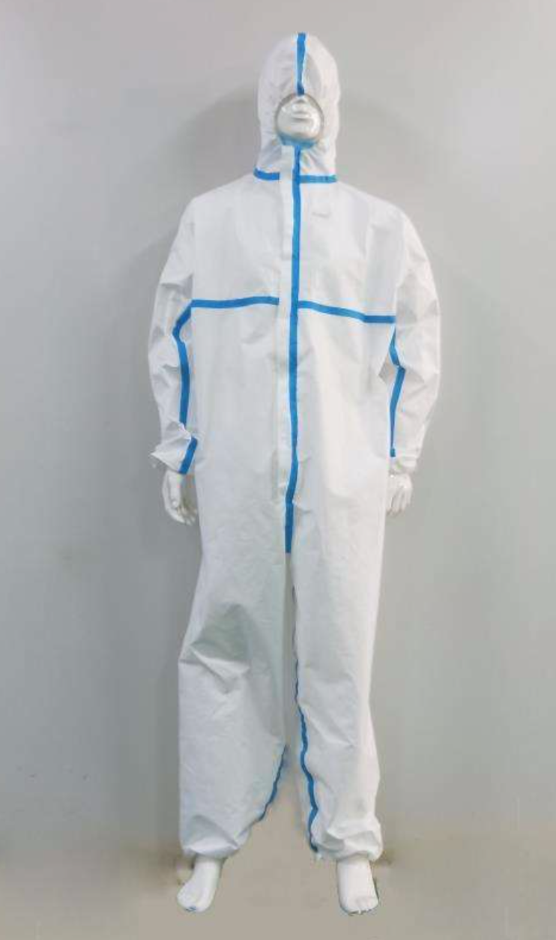
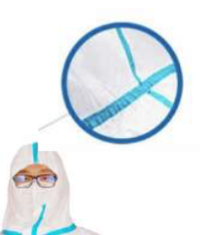
Product Display
Photo

Slide 3
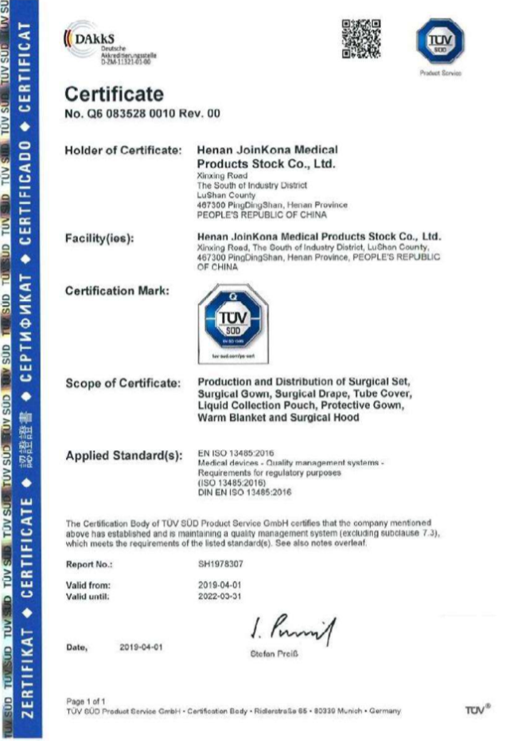
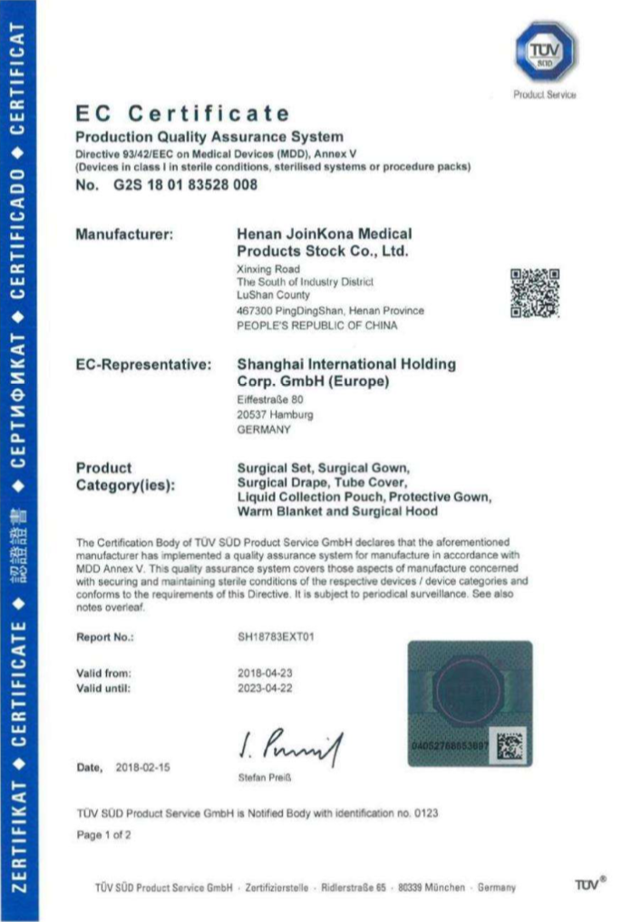
Business & Medical Licenses

Slide 4
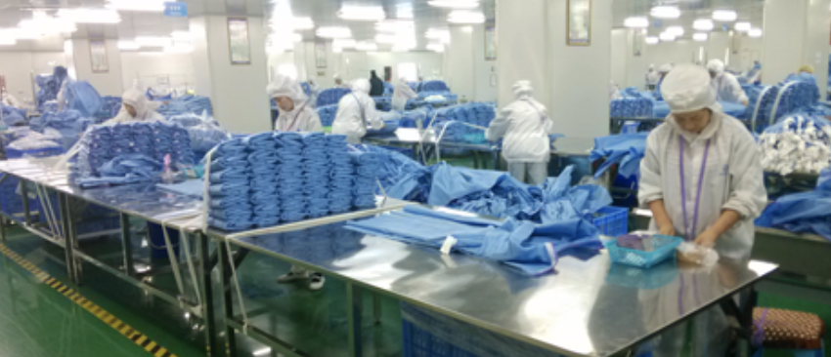
Company Info
Henan Joinkona Medical Products Stock Co., Ltd initially is a incubator project under Shengguang Group. It established in 2011 and step on the stage of disposable non-woven products under the help of ShengguangGroup.
Henan Joinkona Medical Products Stock Co., Ltd started just with a dozen people working team. Under the guidance of general manager Ke Rui, they began the enterprise way of the development. Lasted just 5 years, the general manager of Ke Rui from lead the 30 people to gradually grow which grow into an independent operation of the disposable medical supplies company. Now it occupies 120 thousand square meters and the company own thousands of employees. With all the worker efforts, it has attracted many of the world's leading distributor to join and become a popular legend enterprises. What’s more, industry was praised for the medical industry of a rising.

Slide 5
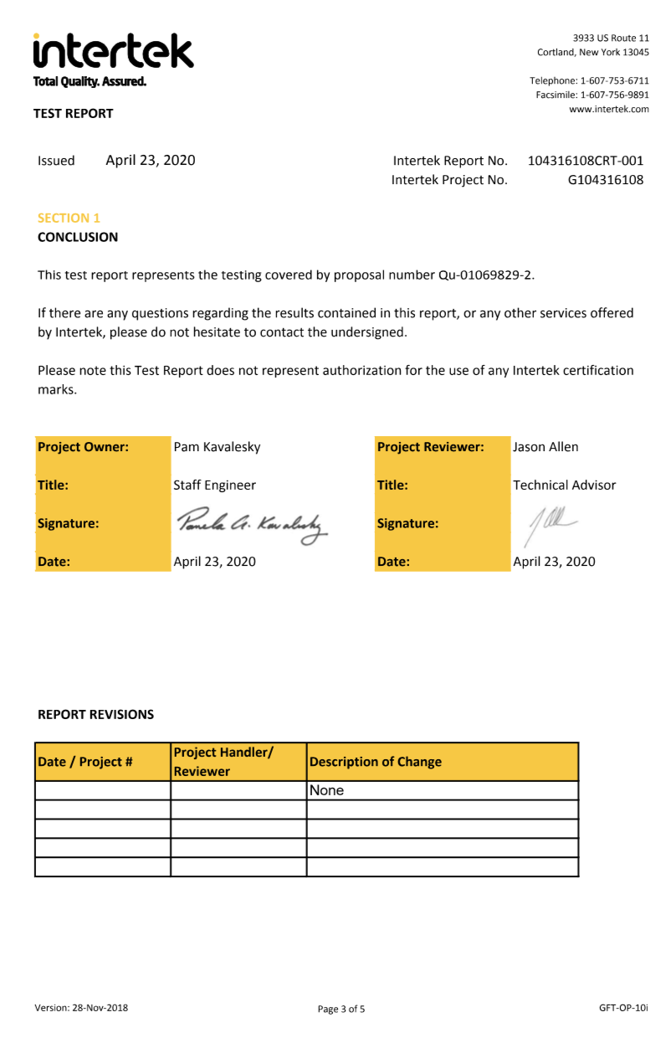
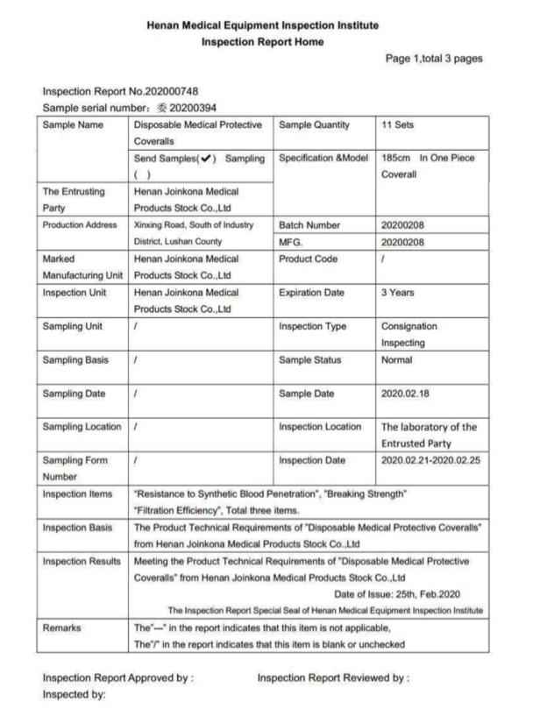
Test Report

Slide 6
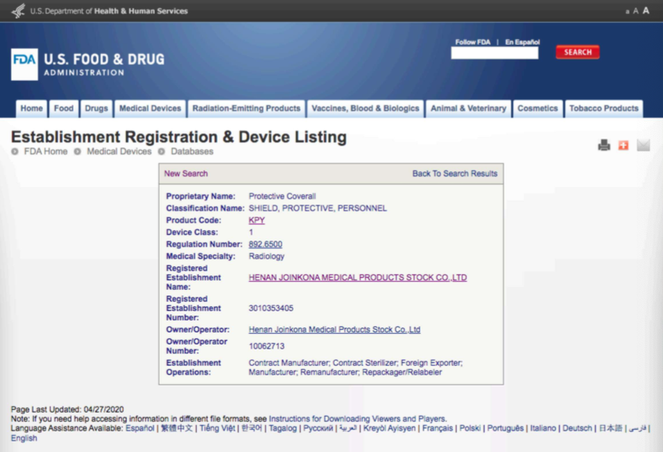
FDA Registration

Slide 7
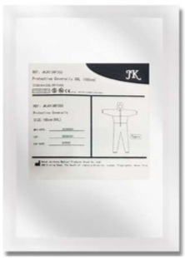
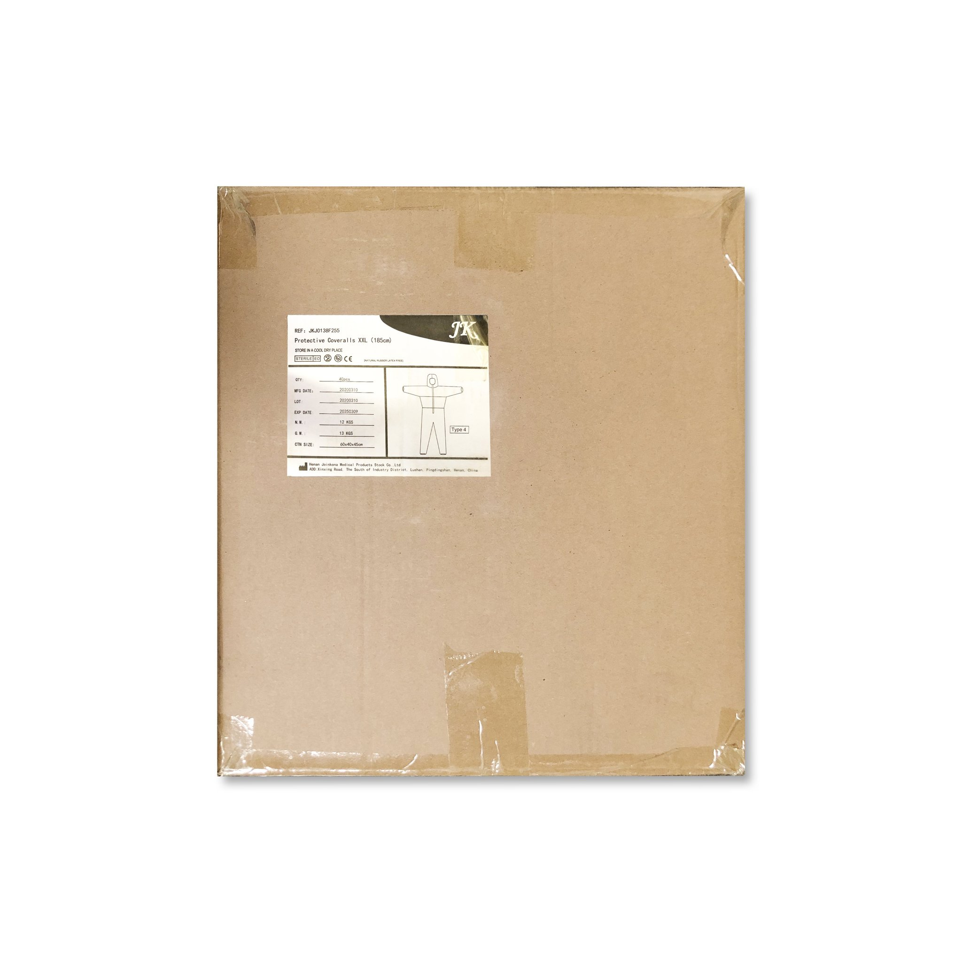
Product Package Info
Inner packaging
Containers/ Carton (Pcs)
Size: 32 x 26 x 0.5 cm
Material: PP+PE
Weight: 63g
Color: White
40 pcs per carton
Carton Dimension: 60 x 40 x 45 cm
G. W.: 12 KG

