Slide 1
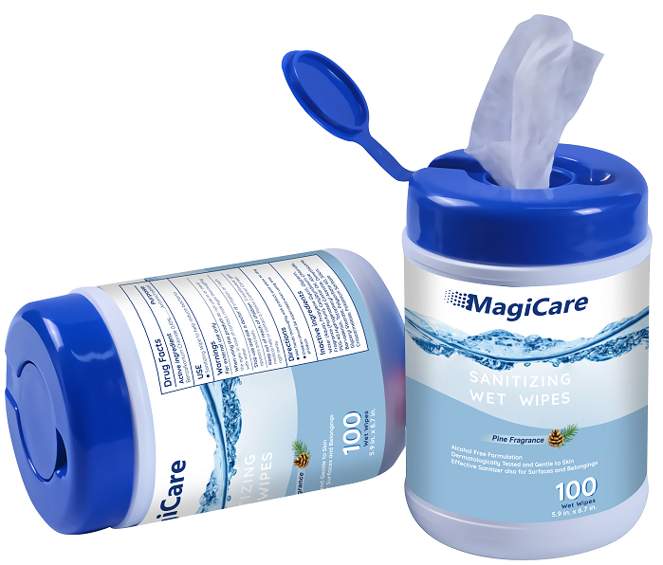

MagiCare Sanitizing Wipes
Key Product Specs:
FDA Registered
Alcohol Free
Dermatologically Tested
Effective Sanitizer
Canister style
Gentle to skin
Scent: Pine

Slide 2
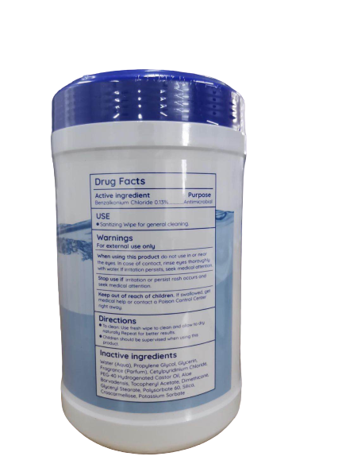
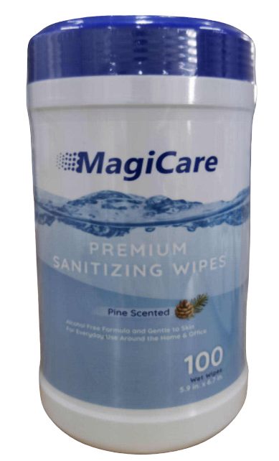
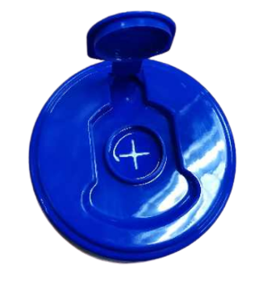
Product Display
Photo

Slide 3
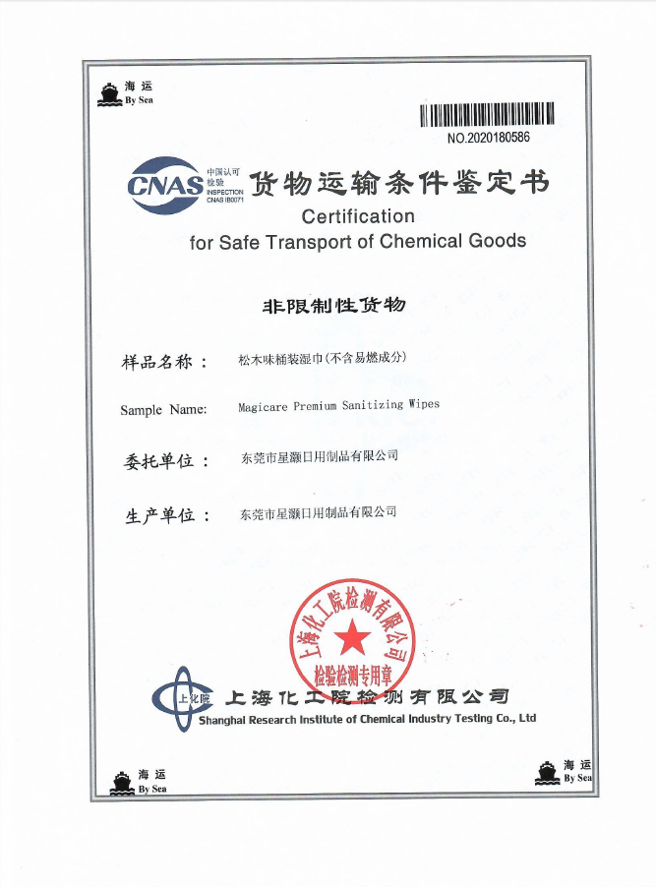
Business & Medical Licenses

Slide 4
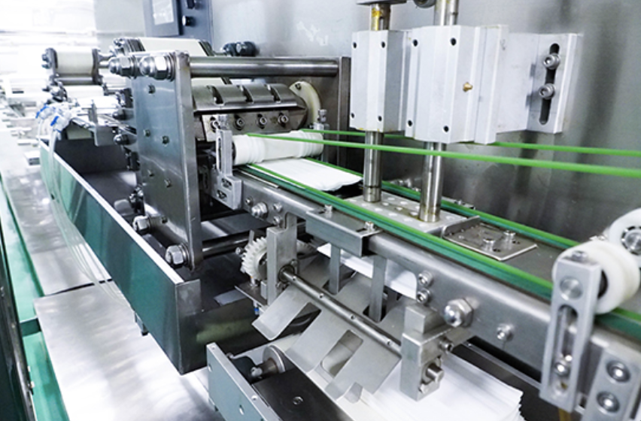
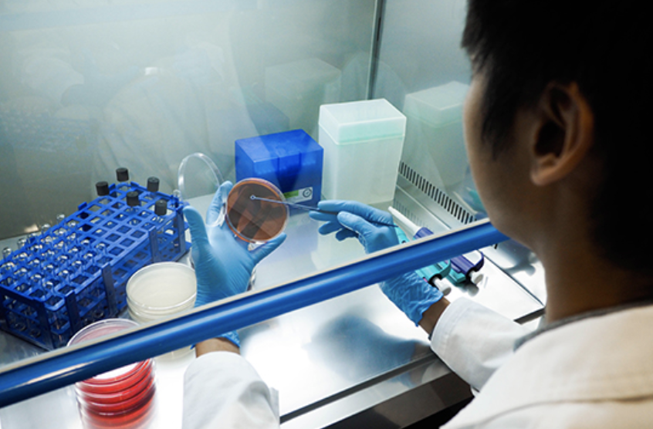
Company Info
Pharmapack Ltd(Hong Kong) is part of the Shine Group of Hong Kong, which was founded in 2000 with its head office in Hong Kong and has sales offices across Asia. The Shine Group of companies have specialized in the supply of pharmaceutical, healthcare, hygiene and skincare products for over 14 years. Our management comprises of Chemists, Pharmacists and Doctors.
Our factory (Dongguan Xinghao Daily Commodity Co., Ltd) for disinfectant and wet wipe products was built in 2002 and has been operated in accordance with Good Manufacturing Practice under the supervision of Industrial Pharmacist since. We have been supplying products to different clients around the world, many of which are famous multinational companies. We began supplying products to the domestic market, China, since 2008 owing to her increasing demands. Our factory is ISO 9001 certified and our formulations, products have been tested by various renowned testing laboratories, such as SGS. We also provide dermatology test certificates upon request.

Slide 5
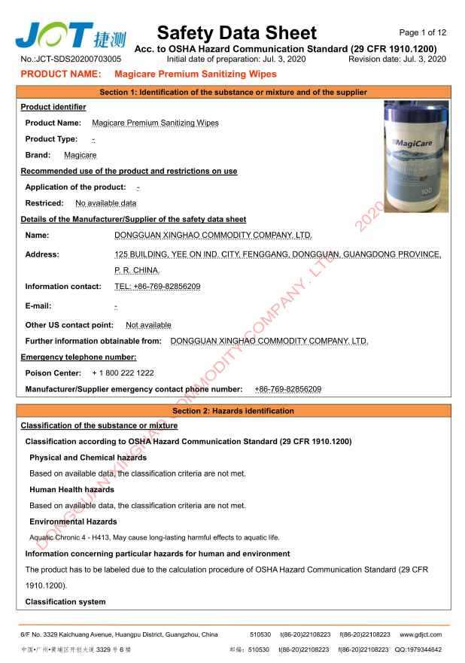
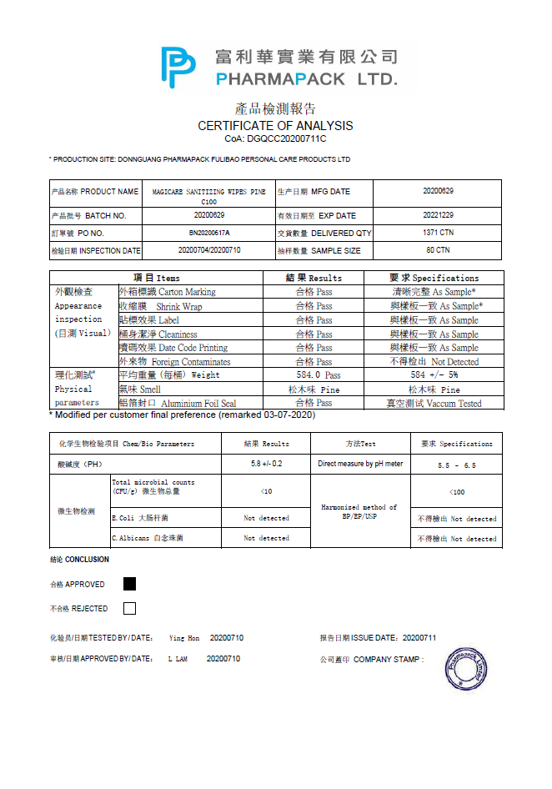
Test Report

Slide 6
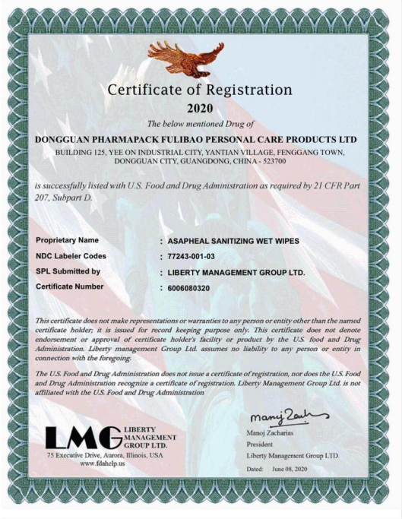
FDA Registration

Slide 7
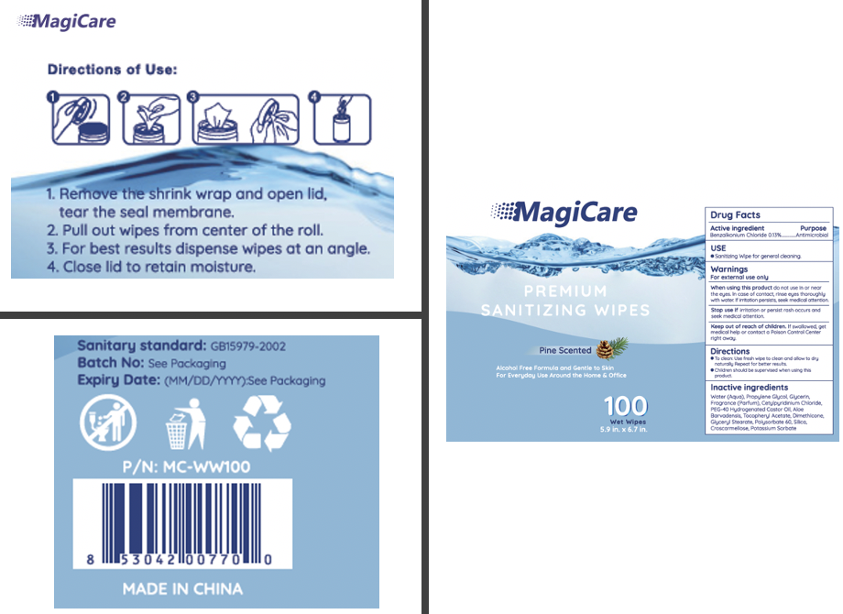
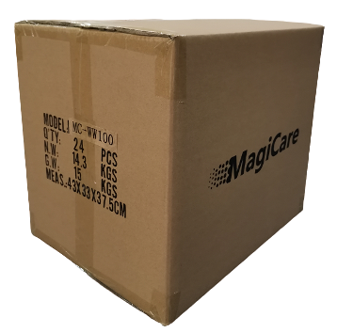
Product Package Info
Inner packaging
Containers/ Carton (Pcs)
100 pcs per Canister
12 canisters/Carton (43.5 x 33 x 19.5 cm)
24 canisters/Carton (43 x 33 x 37.5 cm)
G. W.: 7.5 / 15 KG
Wipe size: 15 x 17 cm
Weight: 45g/wipe
Color: white

