Slide 1
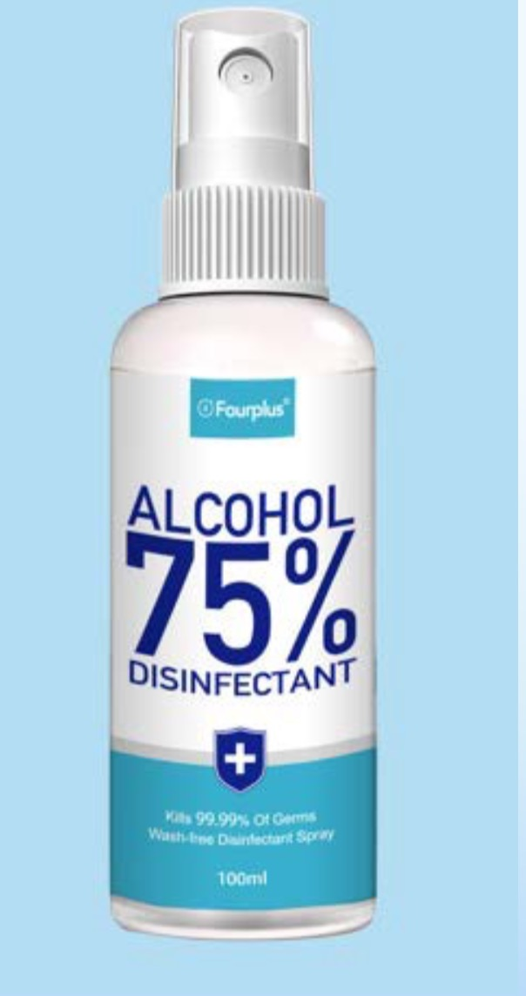
75% Alcohol Disinfectant
Key Product Specs:
FDA Registered
75% Alcohol

Slide 2
Product Display
Photo

Slide 3
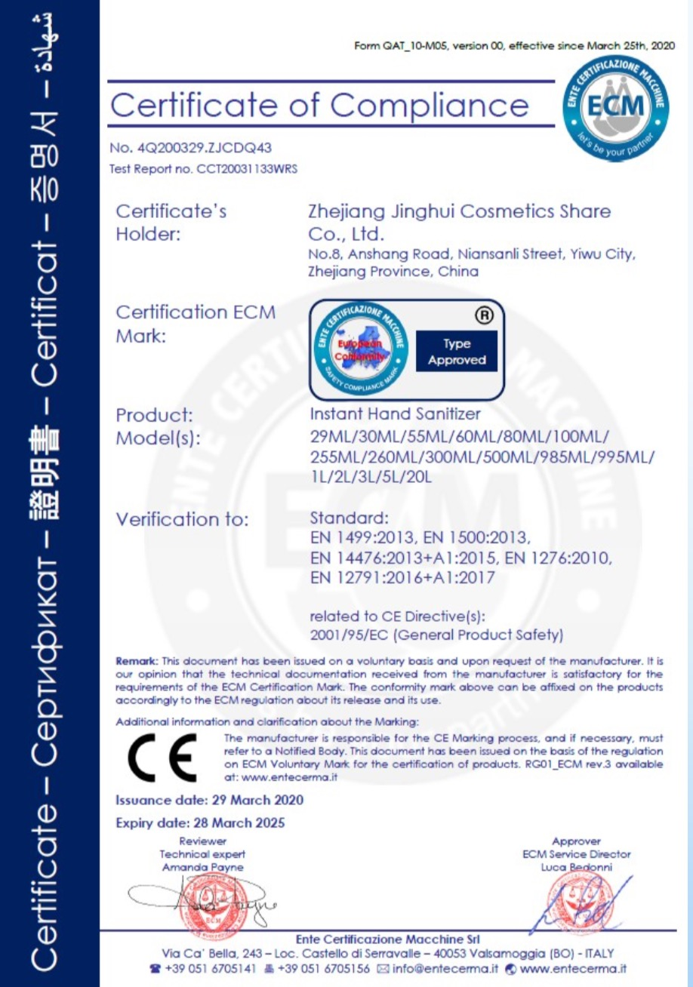
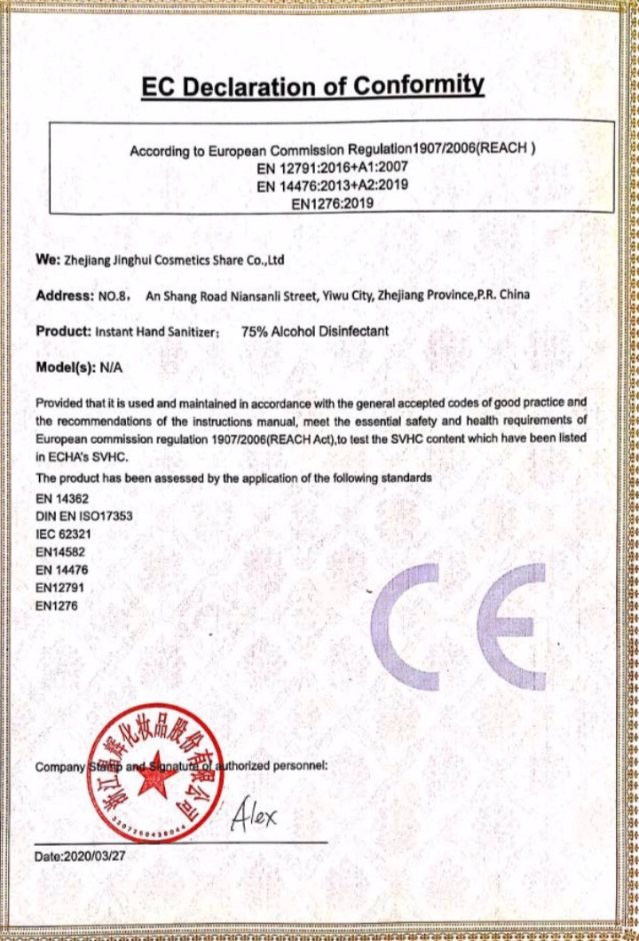
Business & Medical Licenses

Slide 4
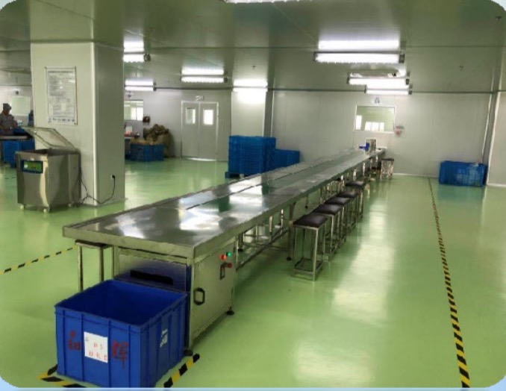
Company Info
Zhejiang Jinghui Cosmetics Share Co.,Ltd is focus on the production of hand sanitizer and alcohol disinfectant, we have 30 production lines, 100,000-level dust-free workshop, 500,000-level packaging workshop, 500 workers, production ability is 1 million bottles/day, and a laboratory with a RD team of 16 people. We have certifacation of FDA,CE,Time-Kill Procedure Test(15 seconds kill 99.99% diseases), Test Report of MSDS,Intertek,TUV.

Slide 5
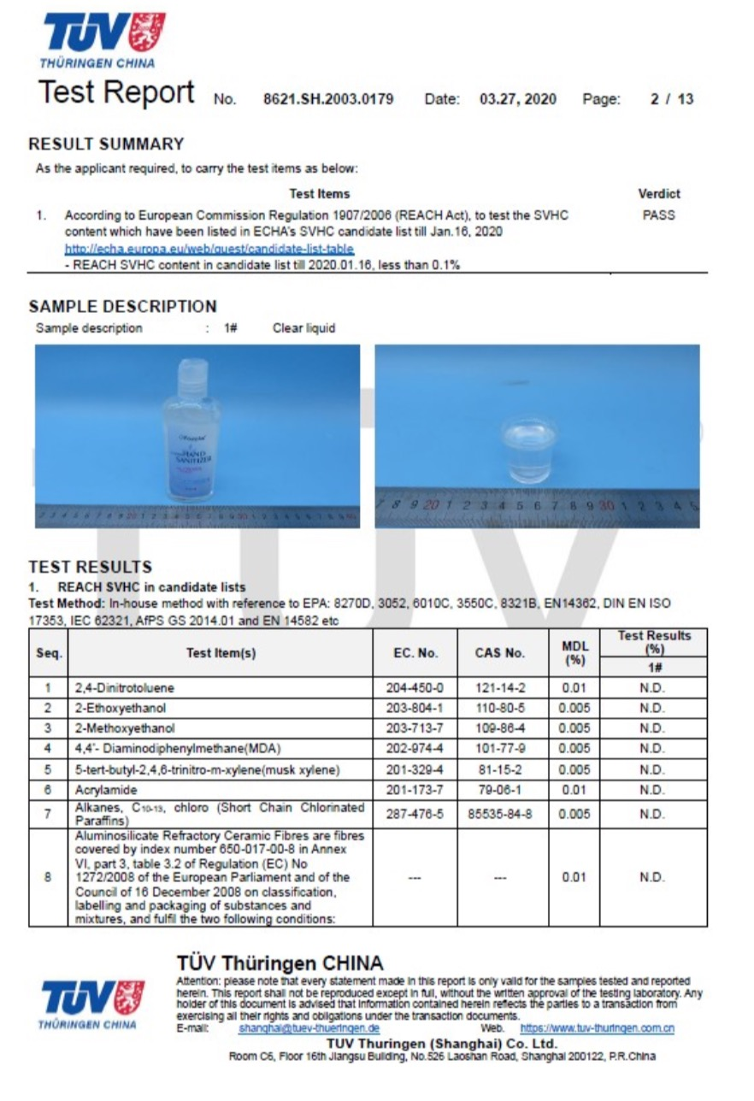
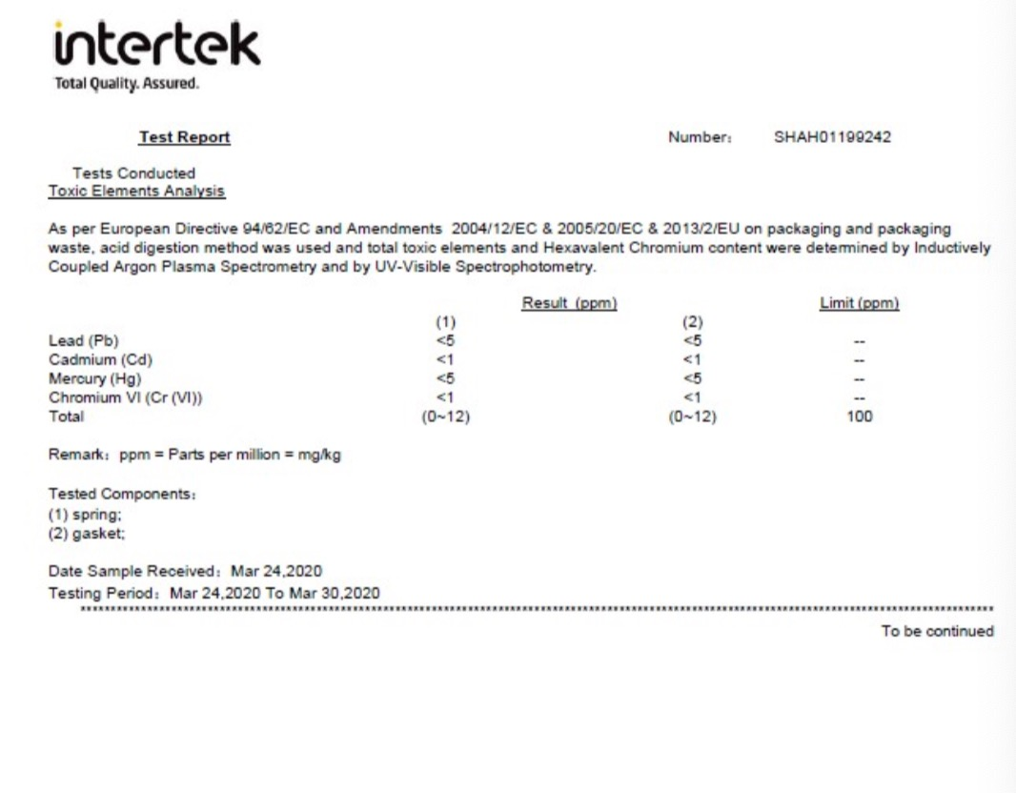
Test Report

Slide 6
FDA Registration

Slide 7
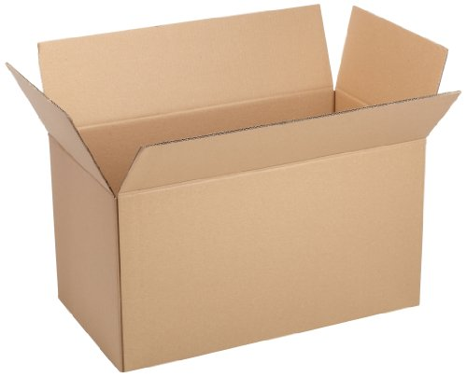
Product Package Info
100ml / bottle
Containers/ Carton (Pcs)
Size: 100ml
Material: water, 75%Alcohol
Color: transparent
Weight: 131g
100ml per bottle, 96 bottles per Carton
Carton Dimension: 43.5*26.4*30cm
G. W.: 12.6KG

